Slide 1
Capital Structure and Leverage
Concept of capital structure;
Business risk and operating leverage;
Financial risk and financial leverage;
Total leverage;
Break-even analysis:
Operating break-even,
Cash breakeven,
Financial break-even analysis

Slide 2
Concept of Capital Structure
Financial Structure : Composition of short term debt, long term debt and equity.
Capital Structure: Mix of long term sources of capital (Long term debt and equity capital)
Optimum Capital Structure : mix of debt, preferred stock and common equity that maximizes the stock price and reduces the cost of capital.
Significance of Capital Structure :
Affects Weighted Average Cost of Capital
Value of the firm
Risk Position

Slide 3
Actors Affecting Capital Structure/ Financial Structure
Sales Stability Assets Structure
Operating Leverage Growth Rate
Profitability Taxes
Control Management Attitudes
Lender Attitudes Market Condition
Interest Rate Firms Internal Condition
Flexibility Legal Requirements

Slide 4
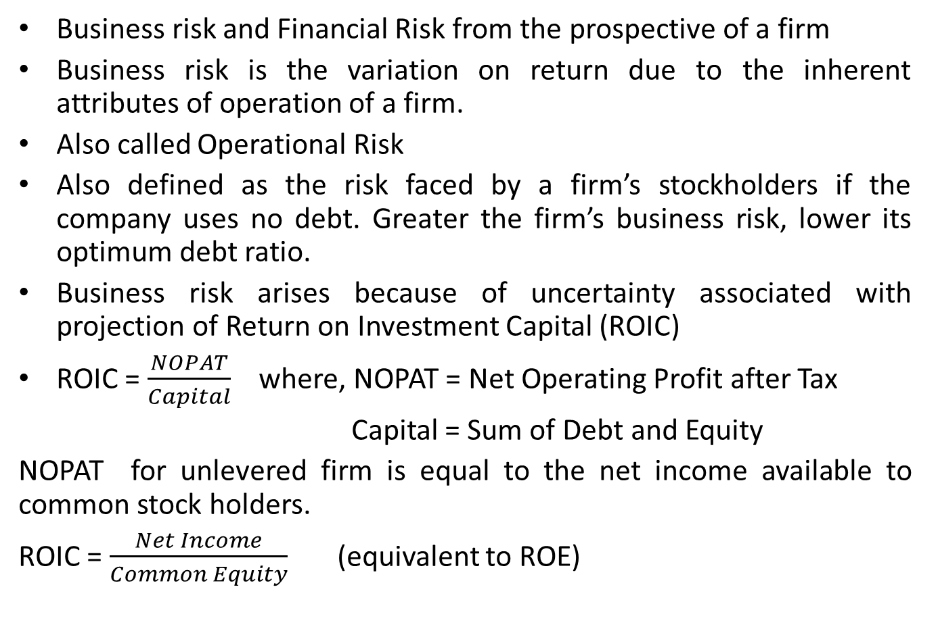
Business Risk and Operating Leverage
Business risk and Financial Risk from the prospective of a firm
Business risk is the variation on return due to the inherent attributes of operation of a firm.
Also called Operational Risk
Also defined as the risk faced by a firm’s stockholders if the company uses no debt. Greater the firm’s business risk, lower its optimum debt ratio.
Business risk arises because of uncertainty associated with projection of Return on Investment Capital (ROIC)
ROIC = $\frac{NOPAT}{Capital}$ where, NOPAT = Net Operating Profit after Tax
Capital = Sum of Debt and Equity
NOPAT for unlevered firm is equal to the net income available to common stock holders.
ROIC = $\frac{Net Income}{Common Equity}$ (equivalent to ROE)

Slide 5
Factors Affecting Business Risk
Demand Variability
Sales Price Variability
Input Cost Variability
The extent to which cost are fixed
Ability to adjust prices for changes in input cost
Ability to produce new product in timely, cost effective manner
Foreign Risk Exposure

Slide 6
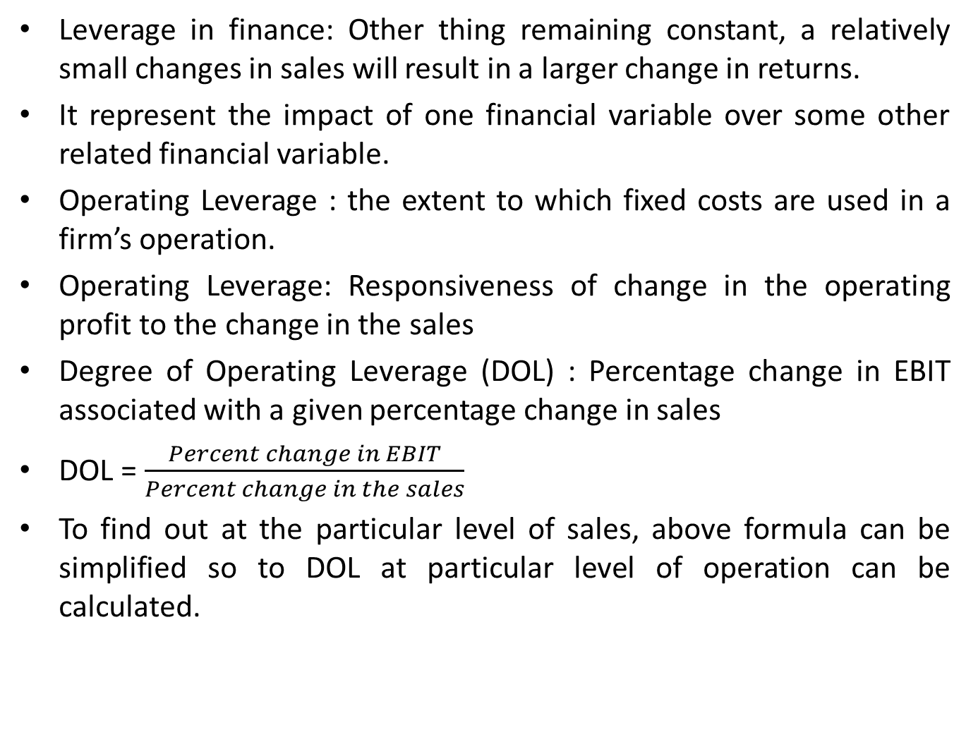
Operating Leverage
Leverage in finance: Other thing remaining constant, a relatively small changes in sales will result in a larger change in returns.
It represent the impact of one financial variable over some other related financial variable.
Operating Leverage : the extent to which fixed costs are used in a firm’s operation.
Operating Leverage: Responsiveness of change in the operating profit to the change in the sales
Degree of Operating Leverage (DOL) : Percentage change in EBIT associated with a given percentage change in sales
DOL = $\frac{Percent change in EBIT}{Percent change in the sales}$
To find out at the particular level of sales, above formula can be simplified so to DOL at particular level of operation can be calculated.

Slide 7
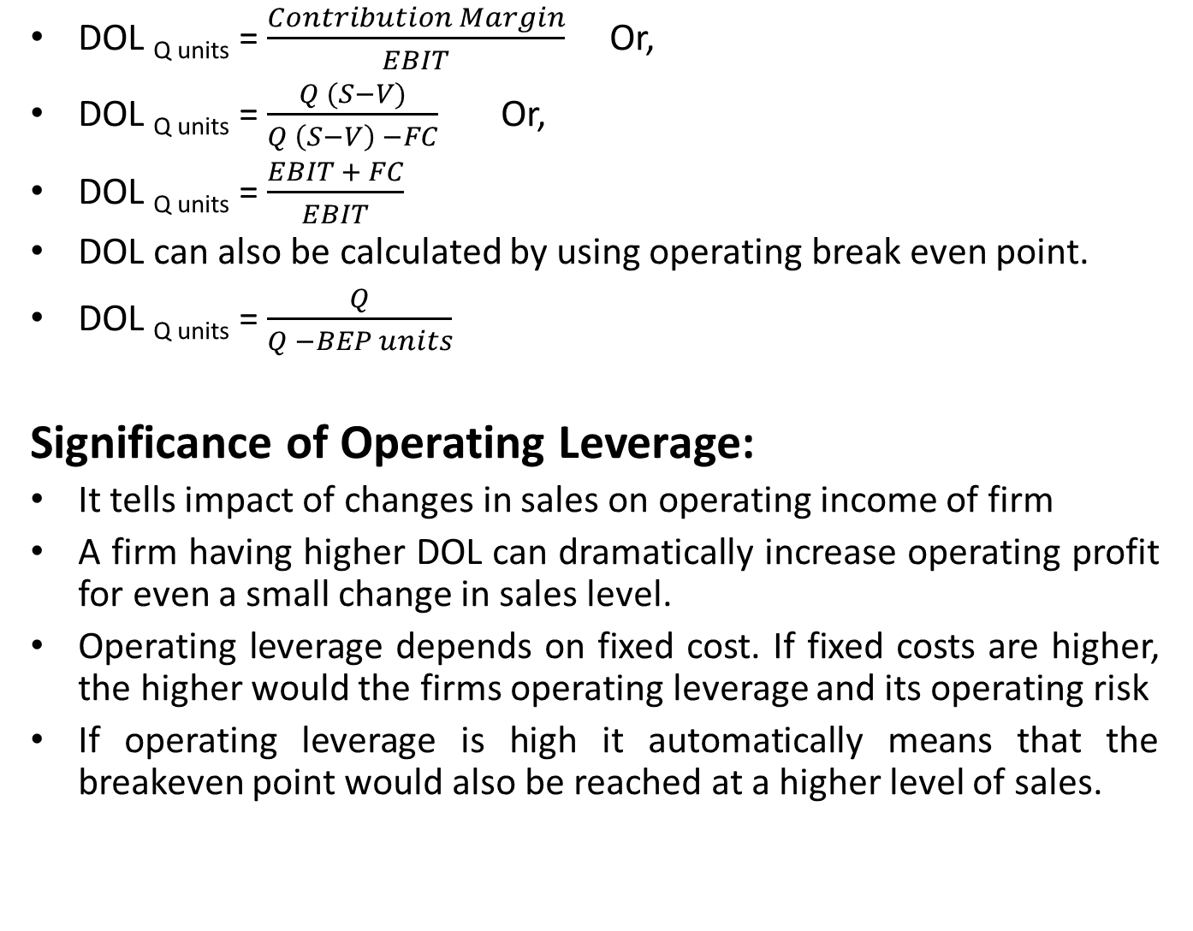
Degree of Operating Leverage (DOL)
DOL _{Q units} = $\frac{Contribution Margin}{EBIT}$ Or,
DOL _{Q units} = $\frac{Q (S−V)}{Q \left(S−V\right) −FC}$ Or,
DOL _{Q units} = $\frac{EBIT + FC}{EBIT}$
DOL can also be calculated by using operating break even point.
DOL _{Q units} = $\frac{Q}{Q −BEP units}$
Significance of Operating Leverage:
It tells impact of changes in sales on operating income of firm
A firm having higher DOL can dramatically increase operating profit for even a small change in sales level.
Operating leverage depends on fixed cost. If fixed costs are higher, the higher would the firms operating leverage and its operating risk
If operating leverage is high it automatically means that the breakeven point would also be reached at a higher level of sales.

Slide 8

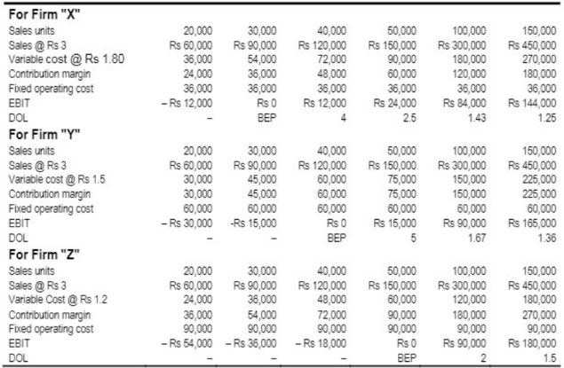
Implication:

Slide 9
Financial Risk and Financial Leverage
Financial Risk : As increase in stockholder’s risk over and above the firm’s basic business risk, resulting from the use of financial leverage.
If firm have no interest expenses or preferred dividends, it has no financial risk
Financial risk is associated with the use of debt capital. More the debt capital a firm uses, higher the financial risk.
Financial Leverage : The extent to which fixed income securities are used in a firm’s capital structure.
Operating leverage sometimes is referred to as first stage leverage and financial leverage is referred as second stage leverage.
Financial leverage explains how a given change in operating income of a firm affects its earnings per share to common stockholders
It is the responsiveness of change in firm’s EPS to the change in EBIT.

Slide 10
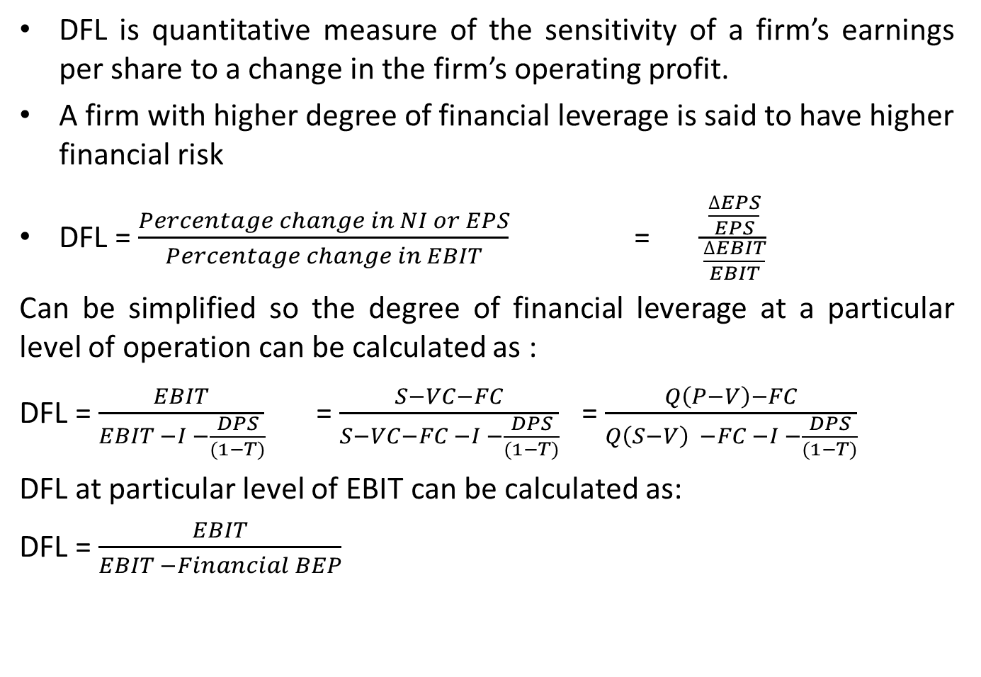
Degree of Financial Leverage (DFL)
DFL is quantitative measure of the sensitivity of a firm’s earnings per share to a change in the firm’s operating profit.
A firm with higher degree of financial leverage is said to have higher financial risk
DFL = $\frac{Percentage change in NI or EPS}{Percentage change in EBIT}$ = $\frac{\frac{∆EPS}{EPS}}{\frac{∆EBIT}{EBIT}}$
Can be simplified so the degree of financial leverage at a particular level of operation can be calculated as :
DFL = $\frac{EBIT}{EBIT −I −\frac{DPS}{(1−T)}}$ = $\frac{S−VC−FC}{S−VC−FC −I −\frac{DPS}{(1−T)}}$ = $\frac{Q\left(P−V\right)−FC}{Q\left(S−V\right) −FC −I −\frac{DPS}{(1−T)}}$
DFL at particular level of EBIT can be calculated as:
DFL = $\frac{EBIT}{EBIT −Financial BEP}$

Slide 11
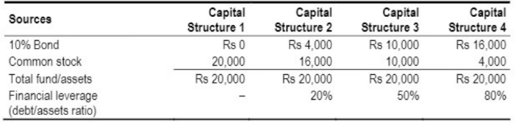
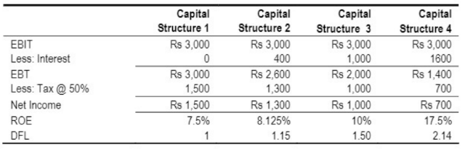
Implication of Financial Leverage

Slide 12
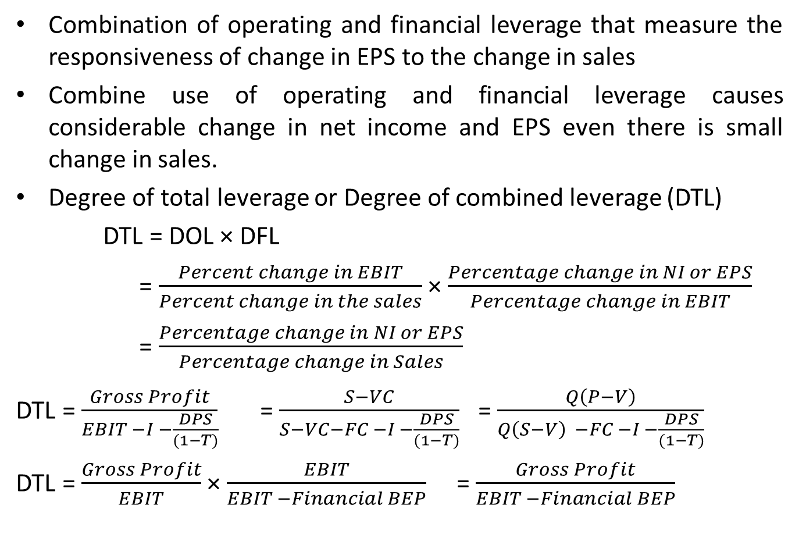
Total Leverage
Combination of operating and financial leverage that measure the responsiveness of change in EPS to the change in sales
Combine use of operating and financial leverage causes considerable change in net income and EPS even there is small change in sales.
Degree of total leverage or Degree of combined leverage (DTL)
DTL = DOL × DFL
= $\frac{Percent change in EBIT}{Percent change in the sales}$ × $\frac{Percentage change in NI or EPS}{Percentage change in EBIT}$
= $\frac{Percentage change in NI or EPS}{Percentage change in Sales}$
DTL = $\frac{Gross Profit}{EBIT −I −\frac{DPS}{(1−T)}}$ = $\frac{S−VC}{S−VC−FC −I −\frac{DPS}{(1−T)}}$ = $\frac{Q\left(P−V\right)}{Q\left(S−V\right) −FC −I −\frac{DPS}{(1−T)}}$
DTL = $\frac{Gross Profit}{EBIT}$ × $\frac{EBIT}{EBIT −Financial BEP}$ = $\frac{Gross Profit}{EBIT −Financial BEP}$

Slide 13
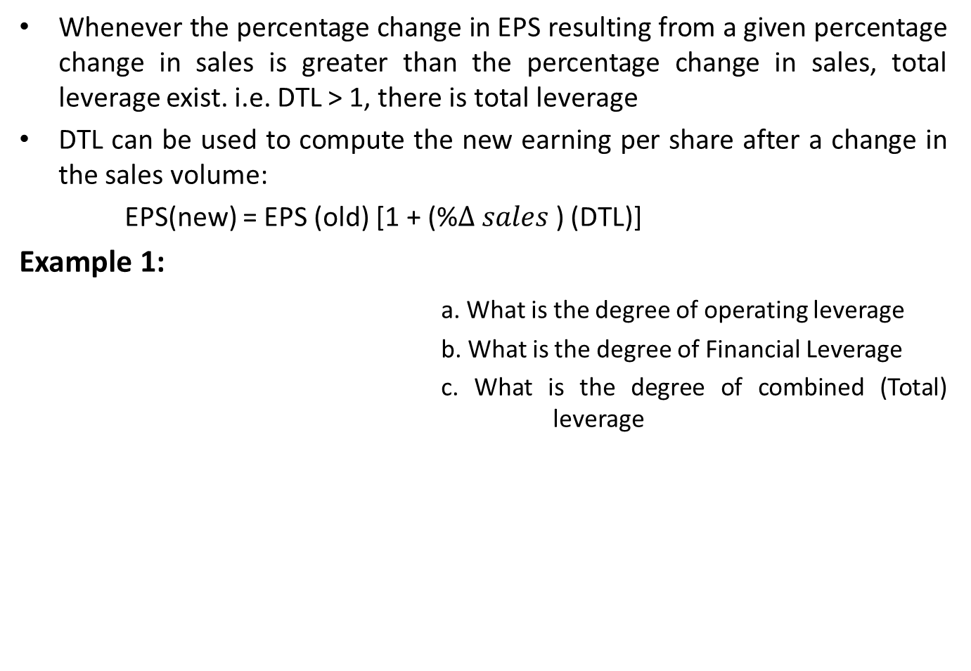
Total Leverage
Whenever the percentage change in EPS resulting from a given percentage change in sales is greater than the percentage change in sales, total leverage exist. i.e. DTL > 1, there is total leverage
DTL can be used to compute the new earning per share after a change in the sales volume:
EPS(new) = EPS (old) [1 + (%$∆ sales$) (DTL)]
Example 1:
a. What is the degree of operating leverage
b. What is the degree of Financial Leverage
c. What is the degree of combined (Total) leverage
Sales | Rs 6,400
Less: Variable Cost | 3,200
Contribution Margin | 3,200
Less: Fixed Cost | 1,600
EBIT | 1,600
Less: Interest | 600
EBT | 1,000
Less: Tax @ 50% | 500
Net Income | 500

Slide 14
Break-Even Analysis
Volume of sales at which revenue is just equal to operating cost
The level of production at which total revenue is equal to total operating costs
Total operating cost of a firm includes some portion of fixed operating cost created by the firm’s fixed investment decisions. This cost may put a firm in loss unless a considerable level of sales is achieved.
Contribution Margin : Profit available to cover the fixed operating cost ( CM = Sales revenue – variable operating cost)
Operating Break-even Point
Cash Break-even Point
Financial Break-even Point

Slide 15
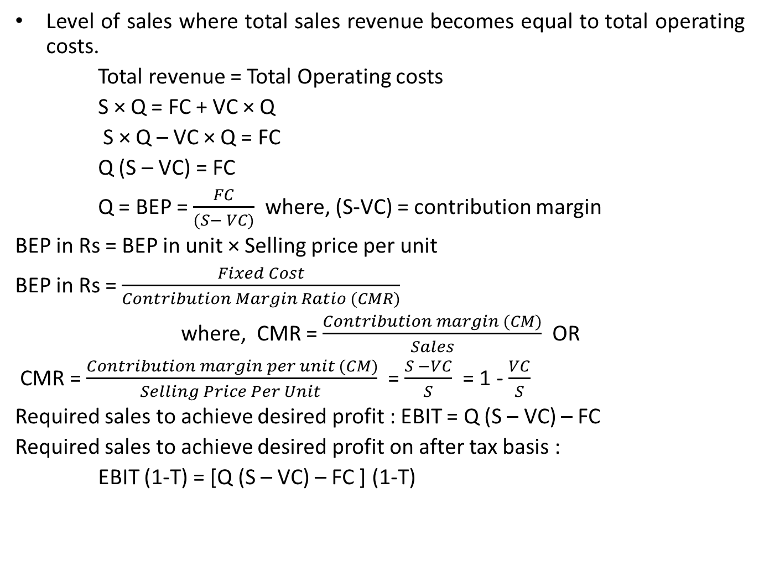
Operating Break-even Point
Level of sales where total sales revenue becomes equal to total operating costs.
Total revenue = Total Operating costs
S × Q = FC + VC × Q
S × Q – VC × Q = FC
Q (S – VC) = FC
Q = BEP = $\frac{FC}{(S− VC)}$ where, (S-VC) = contribution margin
BEP in Rs = BEP in unit × Selling price per unit
BEP in Rs = $\frac{Fixed Cost}{Contribution Margin Ratio (CMR)}$
where, CMR = $\frac{Contribution margin (CM)}{Sales}$ OR
CMR = $\frac{Contribution margin per unit (CM)}{Selling Price Per Unit }$ = $\frac{S −VC}{S}$ = 1 - $\frac{VC}{S}$
Required sales to achieve desired profit : EBIT = Q (S – VC) – FC
Required sales to achieve desired profit on after tax basis :
EBIT (1-T) = [Q (S – VC) – FC ] (1-T)

Slide 16
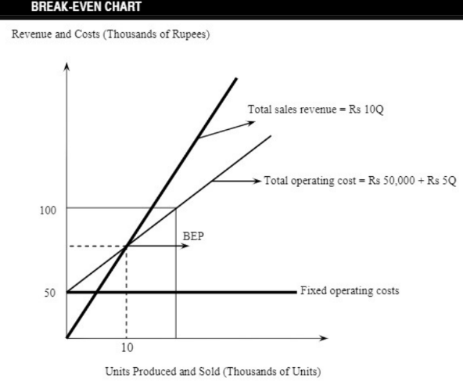
Breakeven chart

Slide 17
Example problems
Example Problem 2: The following relationship exist for ABC Company, a manufacturer of electronic components. Each unit of output is sold for Rs. 10; the fixed cost are Rs. 10,000; variable costs are Rs 5 per unit. Draw a break even chart.
Example Problem 3: The fixed cost of the Karnali Company is Rs 10,000; variable cost is Rs 2 per unit and selling price per unit is Rs 4. Target profit is Rs 6,000 and desired after tax profit is Rs 10,000. the tax rate is 40 percent. Calculate break even point in units and rupees, required sales to target profit of Rs 6,000 and required sales to attain after tax profit of Rs 10,000.

Slide 18
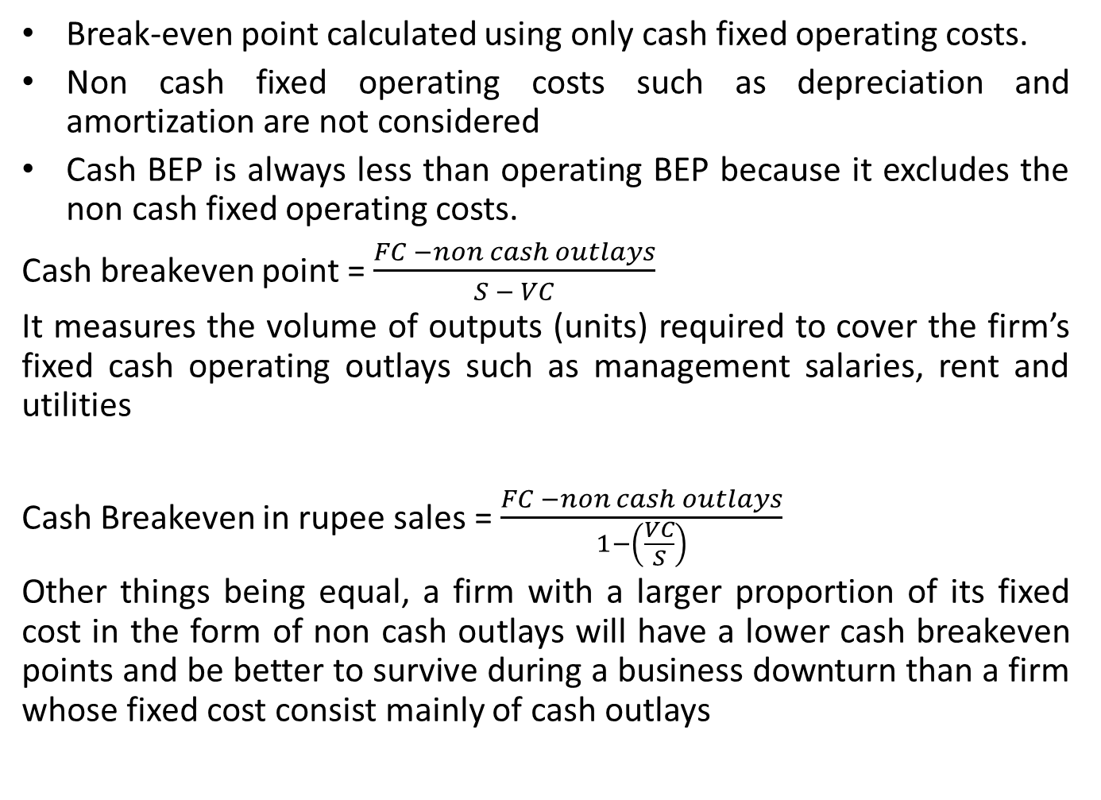
Cash Break-even Point
Break-even point calculated using only cash fixed operating costs.
Non cash fixed operating costs such as depreciation and amortization are not considered
Cash BEP is always less than operating BEP because it excludes the non cash fixed operating costs.
Cash breakeven point = $\frac{FC −non cash outlays}{S − VC}$
It measures the volume of outputs (units) required to cover the firm’s fixed cash operating outlays such as management salaries, rent and utilities
Cash Breakeven in rupee sales = $\frac{FC −non cash outlays}{1−\left(\frac{VC}{S}\right)}$
Other things being equal, a firm with a larger proportion of its fixed cost in the form of non cash outlays will have a lower cash breakeven points and be better to survive during a business downturn than a firm whose fixed cost consist mainly of cash outlays

Slide 19
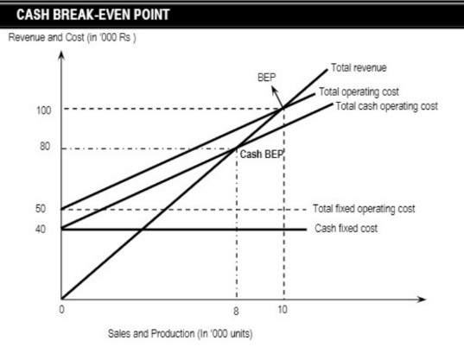
Cash Break-even Point
Example Problem 4: the total fixed operating costs of Rs 50,000 include depreciation in the amount of Rs 2,000. The selling price per unit is Rs 25 and variable cost per unit is Rs 15. Calculate cash breakeven point in units and rupees.

Slide 20
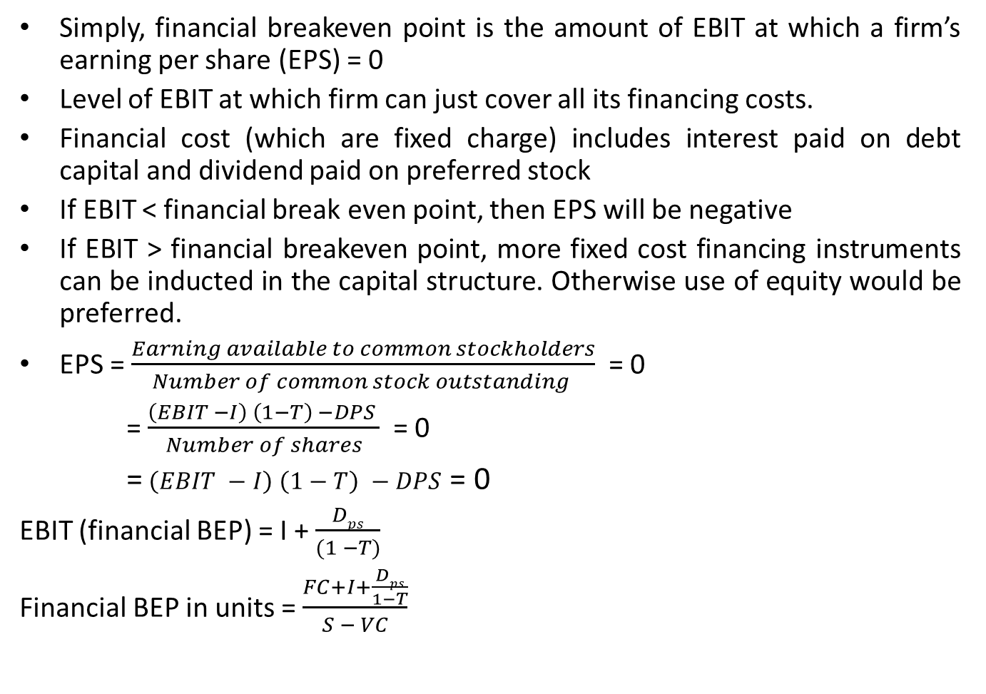
Financial Breakeven Point
Simply, financial breakeven point is the amount of EBIT at which a firm’s earning per share (EPS) = 0
Level of EBIT at which firm can just cover all its financing costs.
Financial cost (which are fixed charge) includes interest paid on debt capital and dividend paid on preferred stock
If EBIT < financial break even point, then EPS will be negative
If EBIT > financial breakeven point, more fixed cost financing instruments can be inducted in the capital structure. Otherwise use of equity would be preferred.
EPS = $\frac{Earning available to common stockholders}{Number of common stock outstanding }$ = 0
= $\frac{\left(EBIT −I\right) \left(1−T\right) −DPS }{Number of shares}$ = 0
= $\left(EBIT −I\right) \left(1−T\right) −DPS$ = 0
EBIT (financial BEP) = I + $\frac{Dps}{(1 −T)}$
Financial BEP in units = $\frac{FC+I+\frac{Dps}{1−T}}{S − VC}$

Slide 21
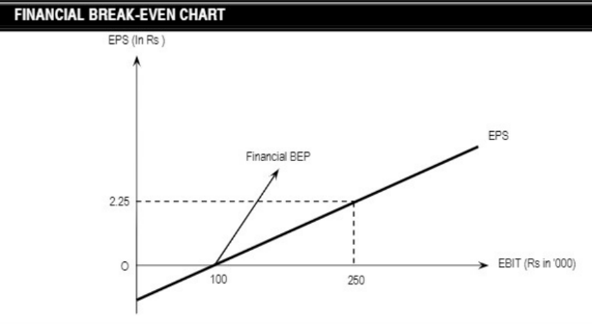
Financial Breakeven Point
.

Slide 22
Financial Breakeven Point
Example Problem 5: Zebra Company has the following partial statement for 2021
Compute the financial breakeven point using graph and formula
Particulars | Amount
Earning before Interest and Taxes | Rs 154
Interest | 37
Earning before taxes | 117
Taxes (40%) | 47
Net Income | 70
Preferred Dividend | 0
Earnings available to common stockholders | 70
Number of shares | 26

Slide 23
Limitation of Breakeven Analysis
Difficult to separate fixed and variable cost
Assume that linear cost and revenue curves which may be unrealistic
Ignores time element as over a long period all costs changes
Breakeven analysis also assume that a firm producing and selling either single product or a constant mix of different products. In many cases product mix changes over time and problems arise in allocation of fixed costs
Breakeven also assume that selling price, variable cost per unit and fixed costs are known at each level of output. In practice these parameters are subject to uncertainty
Breakeven analysis is normally performed for a planning period of one year or less. The benefits received from some costs may not be realized until subsequent periods.

Slide 24
Application of Breakeven Analysis
New Product Decision
Expansion Decision
Modernization and automation projects
Make or buy decision
New Product
Replacement Decision

